Slide 1


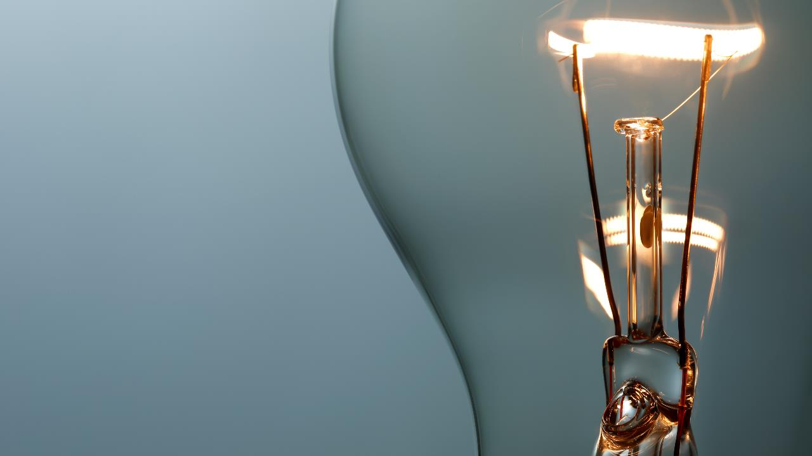
ai in medicine
Ironhack DA
02/08/2022 | Osher Reiser

Slide 2
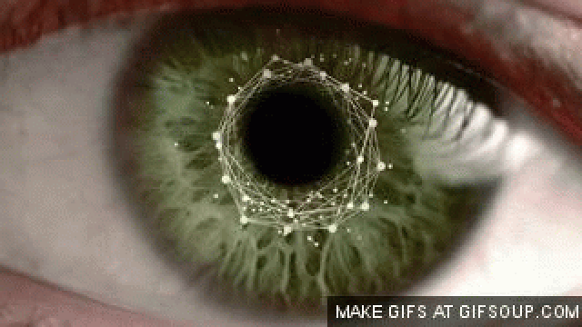
What Google’s AI can see through your eyes

Slide 3
agenda
Model
Importance
Conclusions

Slide 4
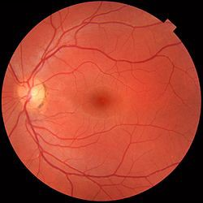
MAN OR A WOMAN?
0.97AUC

Slide 5
Auc
(Area under the Receiver Operating Characteristics Curve)
Measure of performance
How well predictions are ranked
0-1

Slide 6
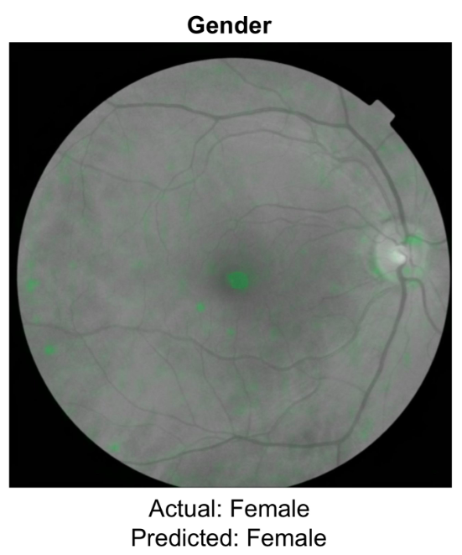
how does it work?
0.71 vessels
0.78 optic disc
0.50 non specific

Slide 7


2018 – No difference between male and female
Hemoglobin levels to detect anemia

Slide 8
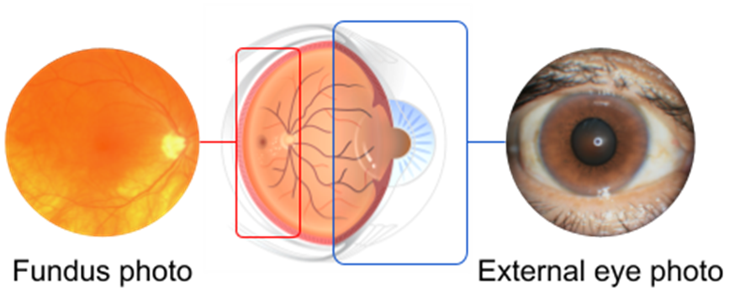
Goals:
Less invasive
Accurate
Less money
Available

Slide 9
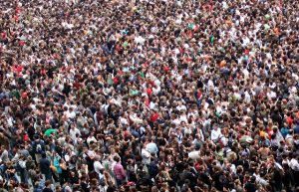
Perfect?
Fundus photos: specialized imaging equipment and a trained technician
Big restriction

Slide 10

Model development
145,000 patients
Diabetic retinal / HbA1c / lipids
0.71 – 0.82
AUC
0.67 – 0.70
AUC
0.57 – 0.68
AUC

Slide 11
Why is it important?
Diabetic retinopathy – leading cause of blindness
By 2040 – 600.000.000 people will have diabetes
200.000.000
Diabetic retinopathy

Slide 12
conclusions
Potential – large population with diabetes
Long way to go to achieve broad applicability:
What level of image?
Generalizing patients with and without known chronic diseases
different cameras (lightning and environment)

Slide 13
In the future...
Further developing and testing on larger datasets
Broadening the set of biomarkers recognized (liver disease)
Non-invasive tools – accessible to everyone

Slide 14

Thank you for listening !

Slide 15
https://medium.com/health-ai/googles-ai-can-see-through-your-eyes-what-doctors-can-t-c1031c0b3df4

